Slide 1
Hiring Process for P&E
Angela Yanes Feb 2021

Slide 2
Content
Ownership Maps + High-Level Overview
FTE Hiring Flow for US / CCOE
FTE Hiring Flow for Amsterdam
AWF Hiring 101 - AWF Classifications
AWF Hiring 101 - Process by country and type of AWF
AWF Hiring 101 - Option 1: Temporary Worker in Fieldglass (UCAN, UKIE, DE, NL, DK)
AWF Hiring 101 - Option 2: SOW in Fieldglass (US only)
AWF Hiring 101 - Option 3: Outsourced AWF in Ariba
AWF Hiring 101 - How to Onboard a New Vendor

Slide 3
Ownership Maps for FTEs and AWFs
Angela Yanes Feb 2021

Slide 4
Current Ownership Map - FTEs
FTE MAP | Hiring Manager | Recruiting Team | Finance / Manager / Other
1. Open req | X
2. Approval |  |  | X
3. Source candidates |  | X
4. First pass / review resumes |  | X
5. Second pass / review resumes | X
6. Send questionnaire to vet experience, salary expectations and fit |  | X
7. Send out link to coding exam + review results |  | X
8. Initial candidate selection |  | X
9. Interview scheduling + candidate management |  | X
10. Interview + feedback + final candidate selection | X
11. Negotiate offer + contract signatures | Varies | X | Varies
10. Onboard candidate (eg. logistics, computer etc.) | X

Slide 5
Current Ownership Map - AWFs
AWF MAP | Hiring Manager | Recruiting Team | Legal | Procurement | Finance / Manager / Other
1. Sign / review MSA | X |  | X | X
2. Discuss details/JD with vendor | X
3. Create a SOW specific to the vendor* | X
4. SOW review / docusign* | X |  | X | X | X
5. Create Job Posting / PR with SOW attached | X
6. Create PO* | X
7. Approve Job Posting + PR + PO | X |  | X | X | X
8. Source candidates | X |  |  | Varies
9. First pass / review resumes | X
10. Send out link to coding exam + review results | X
11. Candidate selection | X |  |  | Varies
12. Interview scheduling + candidate management (in Fieldglass, not integrated with Outlook) | X
13. Interview + feedback + candidate selection | X
14. Negotiate offer + finalize contract | X |  |  | Varies
15. Onboard candidate (eg. logistics, computer etc.) | X
00. Onboard a new vendor to eBay (3-6 months)* | X |  | Restricted help | Restricted help
Note: Steps marked with an * are not always necessary, depending on what type of AWF we are hiring, see slide 14 for more details.

Slide 6
Engineering cost comparison: FTE vs AWF
Eng Roles | FTE Avg. Base | FTE Avg. Bonus | FTE Avg. Benefits | FTE Avg. Sign-On | FTE Avg. RSUs | FTE Avg. Total | AWF Avg Rate
US | $164K | 10% of base | 24% of base | $25K | $125K | $220K | $224K per year
NL | $75K | 10% of base | 21% of base | Usually none $20K exceptions | None | $98K | $255K per year
CCOE | $74K | 10% of base | 26% of base | Usually none Some exceptions | None | $101K | $102K per year
UK | -- | -- | -- | -- | -- | -- | $218 per year
DE | -- | -- | -- | -- | -- | -- | $213 per year
Notes:
All rates in USD, for Engineering roles
Rates are averages for L24/L25 (majority of our reqs)
FTE Avg. Total does not include one-time bonuses like sign on and RSUs (light blue columns)
Rates for AWFs is equivalent to the experience required for a L24/L25
AWF rates from suppliers are per hour but annualized here for comparison - hourly rates available on next slide if interested (in Euros)
UK and DE AWF rates included for comparison. No data available for FTE Eng roles in these countries
eBay only has 3 vendors in Amsterdam: Robert Walters, Tek Systems and Michael Bailey

Slide 7
Challenges Hiring AWFs in Amsterdam - Rates per hour and Eng role type
Roles | NL FTE Rates ~L24/L25 | NL AWF Rates | UK AWF Rates | DE AWF Rates
Full stack developer | €51K - €75K per year (base only) | €100 - €105 per hour €204K - €214K /yr | €82 - €101 per hour €167K - €206K /yr | €75 - €95 per hour €153K - €194K /yr
Front End developer | €51K - €75K per year (base only) | €100 per hour €204K /yr | €82 - €101 per hour €167K - €206K /yr | €75 - €89 per hour €153K - €182K /yr
QA Engineer | €51K - €75K per year (base only) | €95 per hour €194K /yr | €73 - €81 per hour €149K - €165K /yr | €69 - €83 per hour €204K - €170K /yr
Software Engineer | €51K - €75K per year (base only) | €105 - €110 per hour €214K - €224K /yr | €82 - €101 per hour €167K - €206K /yr | €69 - €89 per hour €204K - €182K /yr
Average | €62 per year (base only) | €209 per year | €177.5 per year | €173.5 per year
Notes:
All rates in Euros
US rate for AWFs for comparison is ~€82 per hour (€167K /yr)

Slide 8
Current Challenges & Immediate Needs
Challenges:
Hiring managers own the full process with AWFs
Extremely time-consuming (~20%+ of every manager’s time) - causing huge delays in hiring
Prone to mistakes - one small mistake can reset the whole process
Many approvals and steps, not a streamlined process for AWFs
~1-2 weeks to get 1 req approved/open. Need to manually look up reqs and chase approvers
Immense amount of back and forths between managers, Angela (ops), procurement, finance, etc.
0 support from recruiting - we were getting some help from an AWF in the Buyer team - ending this week
Procurement will assign coordinators to support for certain cases, in a limited fashion
Cost - quality vendors cost more than the average budget we have of $100/hr (usually ~120/hr)
Immediate Needs:
P0. Coordination
Reviewing/submitting reqs
Reviewing initial resumes + code exam
Interview scheduling
Chasing approvals from legal/procurement/finance
→ Short-term plan: Hire an AWF under Procurement or P&E to help ASAP
→ Long-term plan: Assign ownership of a faster, streamlined process across eBay to manage AWF hiring (eg. Recruiting? Procurement?)
P1. End-to-end process ownership to onboard new vendors (3-6 months process):
Discussing eBay’s policies, terms and conditions with Vendor
Opening necessary forms and documentation for Legal and Procurement review
Onboard vendor to eBay/Fieldglass + negotiation of cost cards
→ Ask: Assign ownership of an eBay-wide solution/support for Vendor onboarding (Procurement/Legal?)

Slide 9
FTE Hiring Flow for P&E
Angela Yanes Feb 2021

Slide 10
For US / CCOE Locations
For JD’s directs, it will go to Anne. Ping Angela (ayanes@) if you see delays
Stick to the allowed quarterization. Ask ayanes@ if not sure
Stick to the (1) Location, (2) Level, and (3) Cost Center in the tracker
Ping Angela (ayanes@) if you see any delays
Ping Angela (ayanes@) if you see any delays
Manager’s manager approves
In tracker? (FTE tab)
Have a green light? (eg. open Q1 reqs)
Open req in Workday
Finance approves
Recruiter gets assigned
YES
YES
Enter the req number in the tracker (column P)
NO
NO
Incorrect level / location / cost center will get this req disapproved
!
STOP
STOP
!
Failing to do so will result in Finance approval delays

Slide 11
For Amsterdam
JD directs only: Ping Angela (ayanes@) if you see any delays
Ping Angela (ayanes@) if you see any delays
Ping Angela (ayanes@) if you see any delays
Manager’s manager approves
For AMS, open all reqs regardless of quarterization
Stick to the (1) Level, and (2) Cost Center in the tracker
Finance approves
Recruiter gets assigned
Enter the req # in tracker (column P)
In tracker? (FTE tab)
Have a green light?
Open req in Workday - add correct title*
YES
YES
!
Failing to do so will result in Finance approval delays
Enter brief JD in Column M (Ams tab)
NO
NO
AMS recruiting team starts strategizing to help us
!
Incorrect level / location / cost center will get this req disapproved
Create a Google doc with the JD (template)
STOP
STOP
Recruiting team will help review reqs and language in parallel to approvals to make it fit to The Netherlands’ needs
*Level guide example:
- L23: “Junior Front End Engineer” (2+ yrs exp)
- L24/L25: “Front End Engineer” (4-6+ years exp)
- L26: “Senior Front End Engineer” (8+ years exp)
- L27: “Head of XX” (senior manager)

Slide 12
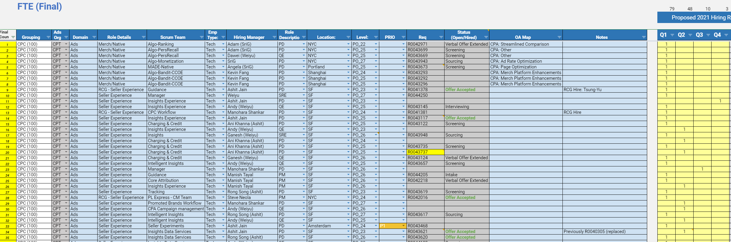
1
Stick to the approved location, level* and quarter when opening your req in WD or it will get rejected
2
Add your req after creating it in WD
* If you decide to hire a level higher, you will need to offset another req to compensate. Example: If you have 2 reqs at L25 and you hire one at L26, you will have to down level the other req to L24.

Slide 13
AWF Hiring Flow for P&E
Angela Yanes
Feb 2021

Slide 14
AWF Hiring 101 - AWF Classifications
Alternative Workforce (AWF) Classification Definitions
Temporary Also known as Temp or Agency Worker | Workers are brought in for short-term assignments to complete specific tasks or projects within a team, assist during peak work periods, or provide coverage for employees who are absent for extended periods.
SoW Includes Independent Contractors, Freelancers and Consultants | Individuals with their own businesses that have passed an evaluation of the IRS' 20-factor test or equivalent local country requirements. They work on milestone deliverable projects for eBay. The project is outlined in a Statement of Work (SoW) and they are responsible for completing the project.
Outsourced Outsourced business functions (e.g. facilities, IT, catering etc.) | Employees or contractors of companies to whom eBay has outsourced whole business functions on an on-going and long-term basis (e.g., call center services, facilities management, mail services). Outsourced Services providers are typically required to go through a formal and competitively bid RFP with negotiated pricing.
 | Temporary | SOW | Outsourced
Recruited by approved AWF Supplier or payroll service | X
Selected by reviewing resumes | X
Paid hourly, weekly, or monthly via submission of timecards | X | Varies
eBay Contact manages how work is done | X
Requires an SoW (Statement of Work) |  | X | X
Payments based on clearly defined milestones/deliverables |  | X | X
AWF Supplier manages individual / personal relationship with AWF. AWF Supplier manages how the work is done. |  | X | X
Has his/her own business license |  | X | X
Ability to work with other clients besides eBay |  | X | X
Entire function/service outsourced to another company |  |  | X

Slide 15
AWF Hiring 101 - Process varies by country and type of AWF
Country of Hire | Temporary Worker (Agency) | Statement of Work (Consultant / Independent / Contractor / Freelancer) | Outsourced Services
USA | Fieldglass | Fieldglass | People X / Ariba
Canada | Fieldglass | People X / Ariba | People X / Ariba
UK | Fieldglass | People X / Ariba | People X / Ariba
Ireland | Fieldglass | People X / Ariba | People X / Ariba
Denmark | Fieldglass | People X / Ariba | People X / Ariba
Germany | Fieldglass | People X / Ariba | People X / Ariba
Netherlands | Fieldglass | People X / Ariba | People X / Ariba
Rest of the World | People X / Ariba | People X / Ariba | People X / Ariba

Slide 16
AWF Hiring 101 - Option 1: Temporary Worker in Fieldglass (UCAN, UKIE, DE, NL, DK)
Stick to the (1) Location, (2) Avg. cost of $100/hr, and (3) Cost Center in the tracker
Stick to the allowed quarterization and prioritization
In tracker? (AWF tab)
YES
Have a green light?
YES
Have you selected a vendor?
YES
Is there an MSA?
YES
Open Job Posting in Fieldglass (see step by step guide)
Procurement, Finance & Manager approvals begin. Interviewing can begin
NO
NO
NO
NO / UNSURE
STOP
STOP
STOP
STOP
!
Incorrect location / total cost / cost center will get this req disapproved.
Contact ayanes@
Contact ayanes@
Contact AWF-advisors@ebay.com to get started
Contact AWF-advisors@ebay.com to confirm
Find your name and project in the tracker. Enter the JPXX number from Fieldglass into column P
Let Angela know that your req is ready (ayanes@)
Angela will work with approvers (Finance, JD)
Open a Work Order in Fieldglass (WOXX)
AWF accepts
Info is sent to PeopleX to start the provisioning process. Check any pending onboarding tasks (eg. systems access and assets)
Officially onboard your AWF
No WO?
!
!
Failing to do so will result in Finance approval delays
Any mismatch with location, total budget or cost center may cause the job posting to be rejected and you may have to start over.
Never onboard an AWF without having all the official approvals
!
STOP
1. Define Your AWF Needs and Create a Job Posting (reference will look like JP0012345):
When creating your Job Posting in Fieldglass (guide):
Managers can choose to start the recruiting process before the position is officially approved and eBay AWF Suppliers will submit candidates for their review.
Managers are responsible for screening resumes, selecting candidates to interview, (re)scheduling interviews in Fieldglass (note that these don’t sync with Outlook), interviewing, providing interview feedback and selecting candidates.
If managers have pre-identified a candidate, they should include the full name, contact phone and email and pay rate information if previously discussed as well as attach their CV.
The job posting you just created will automatically route for funding approval.
For Temporary AWFs, you do not need a SOW, a separate contract or PO.
2. Open a Work Order in Fieldglass to initiate the onboarding process.
The AWF Supplier initiates and confirms background check completion.
Allow extra time for work authorizations and international background checks when planning the start date, especially if you have a role that needs to be filled within a certain time frame.
Track where your AWF is in the process with the AWF Advisors or in Fieldglass.

Slide 17
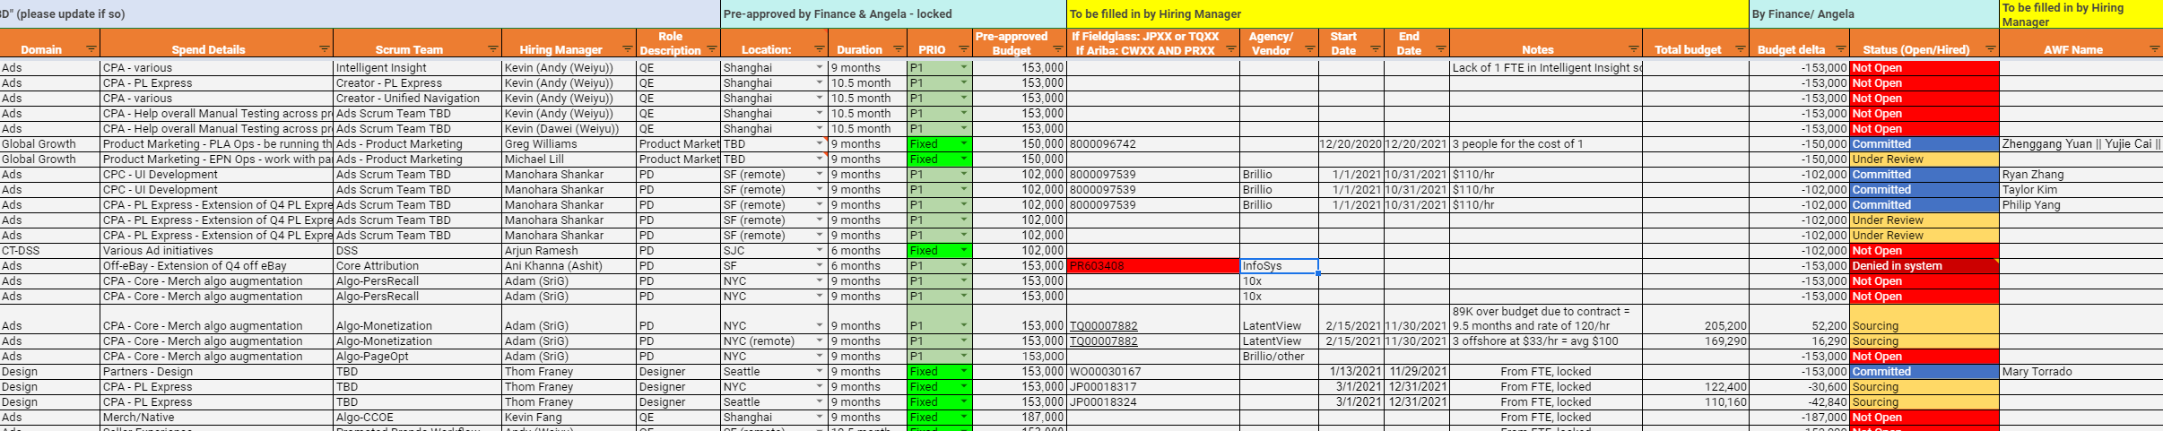

2
Use the approved location and duration to open your req only for the approved prioritization (eg. only P1). Ask ayanes@ if you don’t know what is allowed.
3
Complete columns under the yellow header (“To be filled by HM”) with the information you get from Fieldglass.
1
Find your project and your name. Do not edit a row that does not have your name on it.
In this example, we will look at the bottom 3 lines:
I am the HM (Thom Franey) so I look up my name
I have 3 lines (3 heads) pre-approved by Finance & Ops at $153K
When opening my reqs in Fieldglass, I see that the rate is $80/hr
I go to the calculator tab in the tracker and input: 9 months, 1 person at 80/hr and see that it’s below the pre-approved rate. I can confidently open my JP in Fieldglass for the locations and duration matching the tracker
I add the JP reference to the tracker as well as rate and start/end dates to help Angela and Finance approve my JP
I found one person already so I added the WO for one of them
Once all approvals go through (incl. procurement, etc.) - you’re all done.
Not following these steps may cause your req to be rejected and you may have to start over.

Slide 18
AWF Hiring 101 - Option 2: SOW in Fieldglass (US only)
Stick to the (1) Location, (2) Avg. cost of $100/hr, and (3) Cost Center in the tracker
Stick to the allowed quarter, prio and budget. Ask ayanes@ if in doubt
In tracker? (AWF tab)
YES
Have a green light and pre-approved budget by finance?
YES
Have you selected a contractor?
YES
Is there an MSA? Was contractor screened and passed?
YES
Create an SOW in Fieldglass (see step by step guide)
Procurement (incl. background check), Finance & Manager approvals begin
NO
NO
NO
NO / UNSURE
STOP
STOP
STOP
STOP
Incorrect location / total cost / cost center will get this req disapproved.
Use the calculator tab to calculate the total amount for your SOW.
Contact ayanes@
Contact ayanes@
Contact AWF-advisors@ebay.com to get started
Contact AWF-advisors@ebay.com to confirm
!
Find your name and project in the tracker. Enter the TQXX number from Fieldglass into column Q
Let Angela know that your req is ready (ayanes@)
Angela will work with approvers (Finance, JD)
Contract signed
Info is sent to PeopleX to start the provisioning process. Check any pending onboarding tasks (eg. systems access and assets)
Officially onboard your AWF
SOW not approved yet?
!
!
Failing to do so will
result in Finance
approval delays
Any mismatch with location, total budget or cost center may cause the job posting to be rejected and you may have to start over.
Never onboard an AWF without having all the official approvals
!
STOP
1. Define Your AWF Needs and Create a Statement of Work (SOW) (reference will look like EBAYTQ0012345):
When creating your SOW in Fieldglass (guide):
Managers are responsible for screening resumes, selecting candidates to interview, (re)scheduling interviews in Fieldglass (note that these don’t sync with Outlook), interviewing, providing interview feedback and selecting candidates.
The job posting you just created will automatically route for funding approval.
You do not need a PO.
2. The AWF Supplier initiates and confirms background check completion.
Allow extra time for work authorizations and international background checks when planning the start date, especially if you have a role that needs to be filled within a certain time frame.
Track where your AWF is in the process with the AWF Advisors or in Fieldglass.

Slide 19
2
Use the approved location and duration to open your req only for the approved prioritization (eg. only P1). Ask ayanes@ if you don’t know what is allowed.
3
Complete columns under the yellow header (“To be filled by HM”) with the information you get from Fieldglass.
1
Find your project and your name. Do not edit a row that does not have your name on it.
In this example, we will look at the rows highlighted in green:
I am the HM (Adam) so I look up my name and project
I have 2 lines pre-approved by Finance & Ops at $153K
When talking to the consultant agency, I see that I can hire people remotely for a fraction of the cost of an onsite hire
I go to the calculator tab (see next slide) in the tracker and input: 9 months, 2 people at 120/hr (fee of this agency) and see that it’s above the pre-approved rate. I email/ping Angela before I create my SOW to ensure it will get approved
Angela works with Finance and finds some buffer, so she approves. I now open my SOW with one onsite matching location in the tracker, and 3 remote (for the price of one head)
I add the TQ reference to the tracker as well as rate and start/end dates with a note that the SOW has more people than the 2 heads but the rates eventually match the agreed amount. This is to help Angela and Finance approve my SOW and keep track of the financials
Once all approvals go through (incl. procurement, etc.) - you’re all done.
Not following these steps may cause your req to be rejected and you may have to start over.

Slide 20
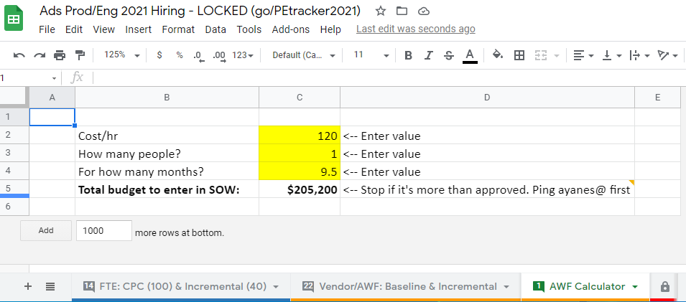
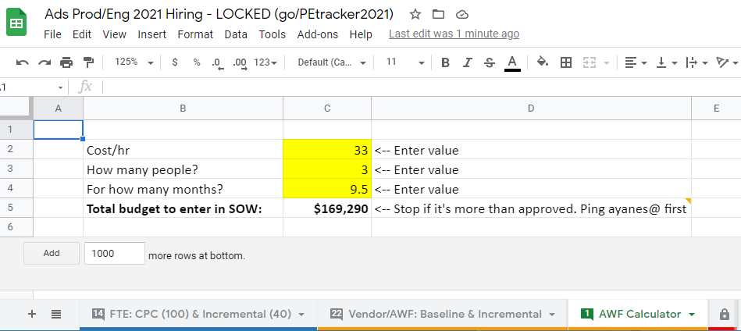
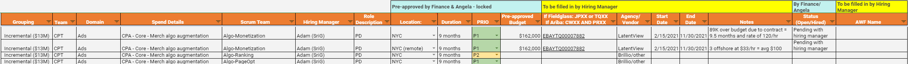
In the calculator tab, enter the information you negotiated with your vendor
In this case, we kept 1 onsite at a higher rate, and converted the other line item into 3 remote at ⅓ of the rate, totalling 4 people:
1 @ 120/hr
3 @ 33/hr each (100/hr total)
= ~375K
Compare your new total to the pre-approved amount in our tracker, talk to ayanes@ prior to submitting your req if amount is above the pre-approved amount.
Not following these steps may cause your req to be rejected and you may have to start over.

Slide 21
AWF Hiring 101 - SOW Examples
The tracker is showing one line per approved HC to be hired.
You have 10 lines in the tracker under your name. 6 are for project A, 2 are for project B.
You go to Fieldglass to open your req for project A and in your SOW you state that you want 6 AWFs for a rate of $100/hr for 9 months.
You check in the calculator and see that the total budget would equal to ~918K, which matches your pre-approved budget (if you add up all 6 lines).
You fill everything in as per the tracker and now get a TQ reference number (eg. EBAYTQ0012345). Add this number to Column P for the 6 lines that map to your project A.
You have Project B with 2 people, but you hire 1 onsite at $100/hr for 9 months, and use the equivalent $100/hr of the remaining HC to get 3 offshore at $33/hr, also for 9 months.
After confirming budgets are good to go, you add your TQXX number to the 2 rows, and add a note in Column T with “1 onsite at 100/hr, 3 offshore at $33/hr”. The total budget should always match.
If budget is above the average $100/hr, please also add that to column T after Angela approves (eg. “contract with vendor was only possible at $120/hr”).
Do your best to offset being over budget with another project. Maybe one project is at $120/hr, but you manage to get another project at $80/hr with another agency. Always try to balance out your budget.

Slide 22
AWF Hiring 101 - Option 3: Outsourced AWF in Ariba
Stick to the allowed quarter, prio and budget. Ask ayanes@ if in doubt
Include job needs, location, total cost, headcount, etc. ayanes@ will review with Finance and ensure it’s good to submit
In tracker? (AWF tab)
YES
Have a green light?
YES
Is there an approved contract?
YES
Create an SOW as per vendor’s needs and review with ayanes@ prior to submitting (Sample)
Create a SpendSmart ID and open a Purchase Requisition (PR). Attach SOW
Open a Purchase Order (PO) in Ariba - instructions
STOP
NO
STOP
NO
NO
Need help?
Incorrect information will get this req disapproved.
Use the calculator tab to get the total amount for your SOW
Contact ayanes@
Contact ayanes@
Onboard a new vendor here. More info here.
For more help creating an SOW, contact AWF-advisors@ebay.com.
For help with the budget, contact ayanes@
!
Legal, procurement (incl. background check), Finance & Manager approvals begin (CWXX ref is for Legal review)
Find your name & project in the tracker. Add PR/PO refs in column P and SOW cost & HC details in column T to help with finance & VP approvals
Approved SOW docusigned by vendor and manager / VP
Contract signed
Info is sent to PeopleX to start the provisioning process. Check any pending onboarding tasks (eg. systems access and assets)
Officially onboard your AWF
SOW not approved yet?
Mismatches with pre-approved location, budget or cost center will cause the req to be rejected and you will have to start over
!
!
STOP
Never onboard an AWF without having all the official approvals
Managers are responsible for:
Engaging in conversations with new vendor and explain expectations, roles, etc. (many back and forths)
Initiating and owning process with Legal and Procurement to onboard a new vendor (3-6 months process)
Screening resumes, selecting candidates to interview, (re)scheduling interviews, interviewing, providing interview feedback and selecting candidates

Slide 23
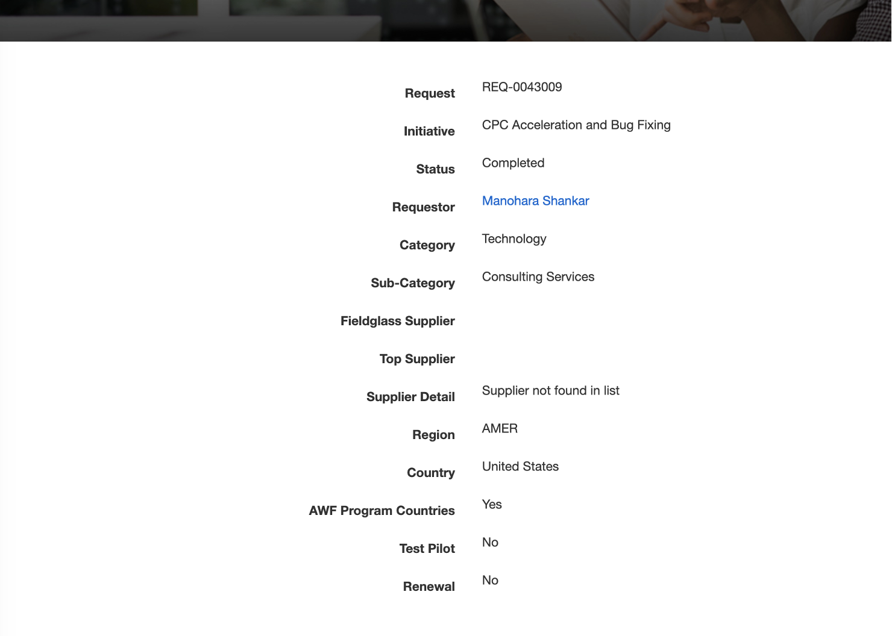
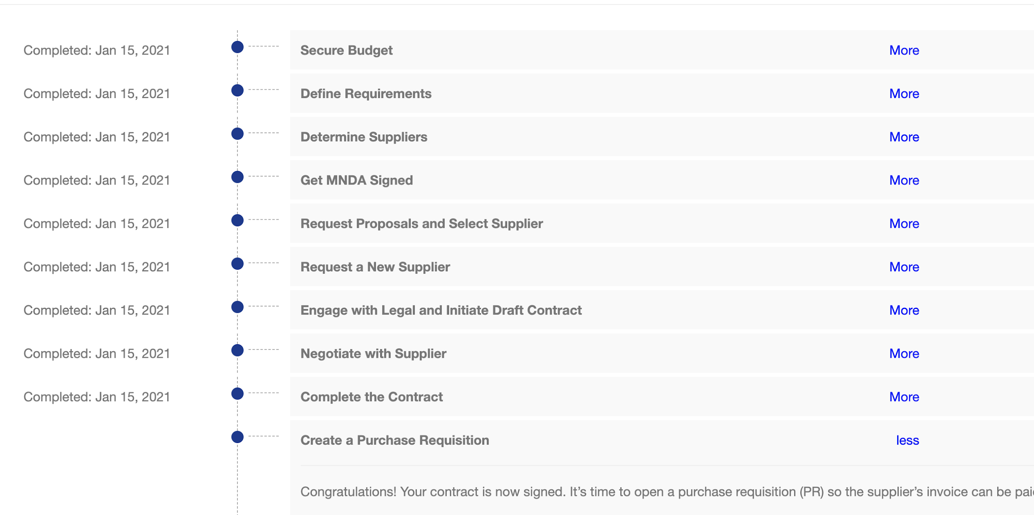
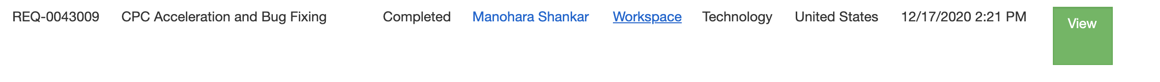
AWF Hiring 101 - Option 3: Outsourced AWF in Ariba
1
Open SpendSmart ID
3
Workspace to navigate to tasks to be completed. Use Ariba to create the SOW flow by selecting “Engage with Legal and Initiate Draft Contract”
2
See your request summary

Slide 24
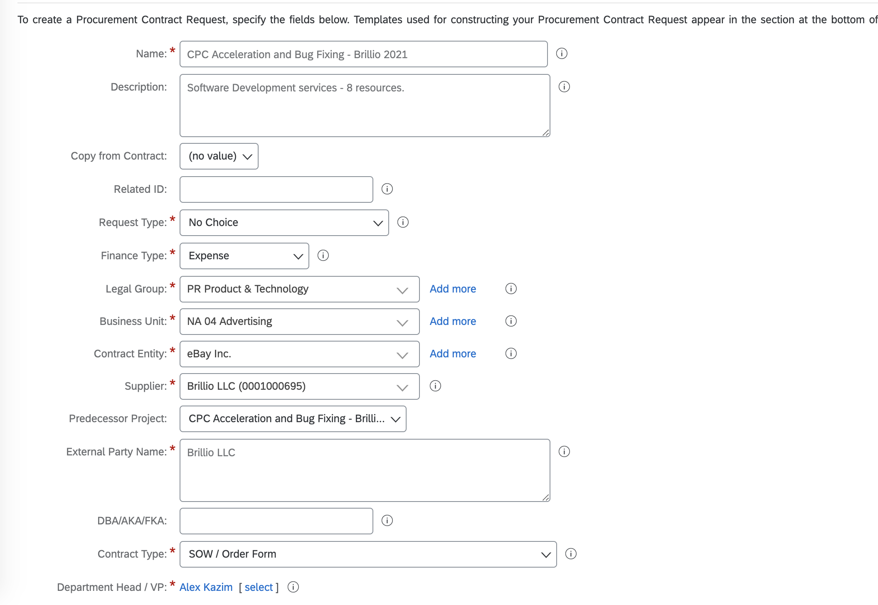
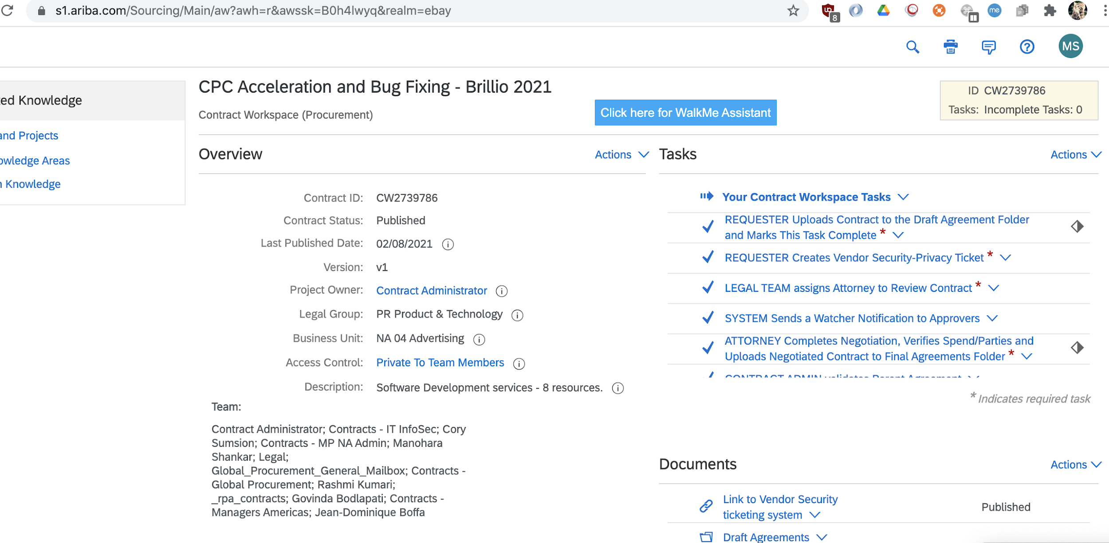
AWF Hiring 101 - Option 3: Outsourced AWF in Ariba
4
5
Continue to create the contract
Once the request is created, complete the “Requester creates the Vendor Security-Privacy ticket” within the SOW request
Notes:
Upload the SOW template using “Requester uploads contract to the draft agreement folder”.
Once the SOW gets approved by the Procurement, Legal, infosec teams.
Select the “PR requisition” step within the spendsmart tool to create the PR/PO.

Slide 25
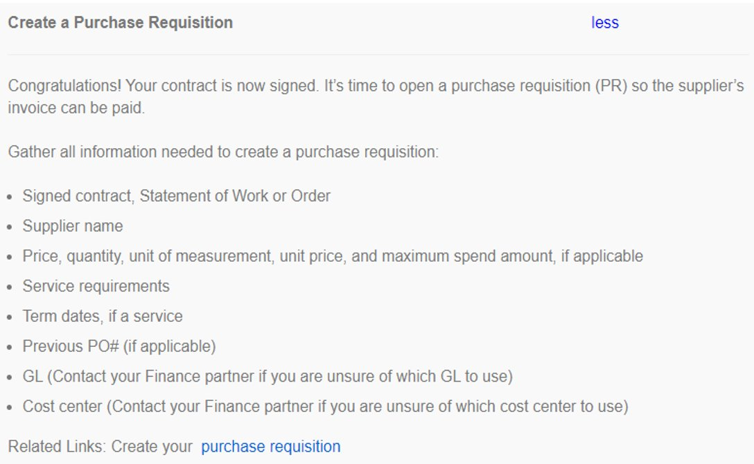
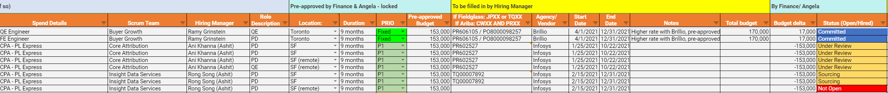
AWF Hiring 101 - Option 3: Outsourced AWF in Ariba
6
7
Upload the SOW template by selecting “Requester uploads contract to the draft agreement folder”
Once the SOW gets approved by the Procurement, Legal, and Infosec teams, select the “PR requisition” step within the spendsmart tool to create the PR/PO.
8
Check out this training to open a PR/PO and add your ref and any notes to our tracker

Slide 26
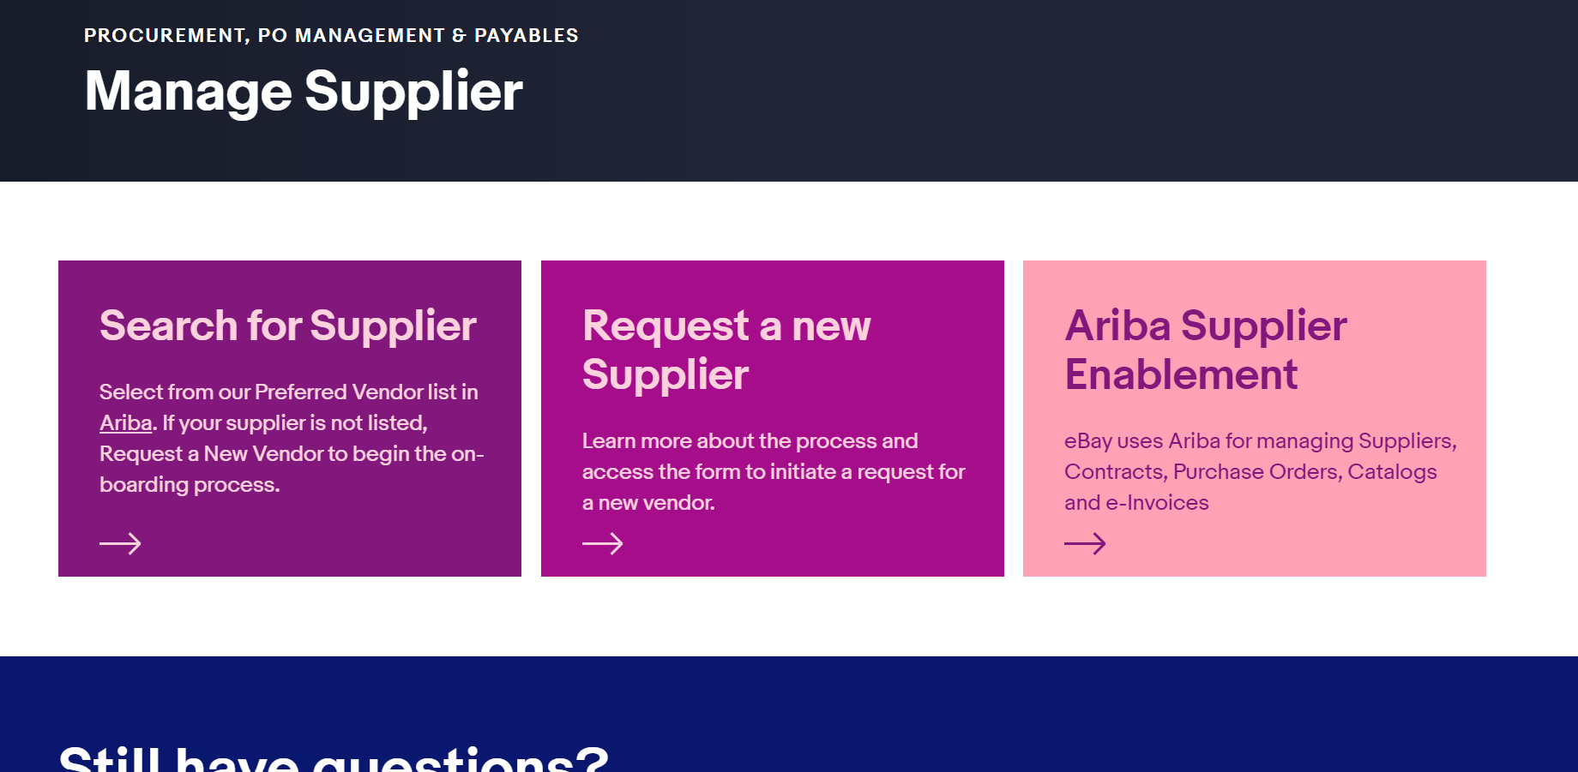
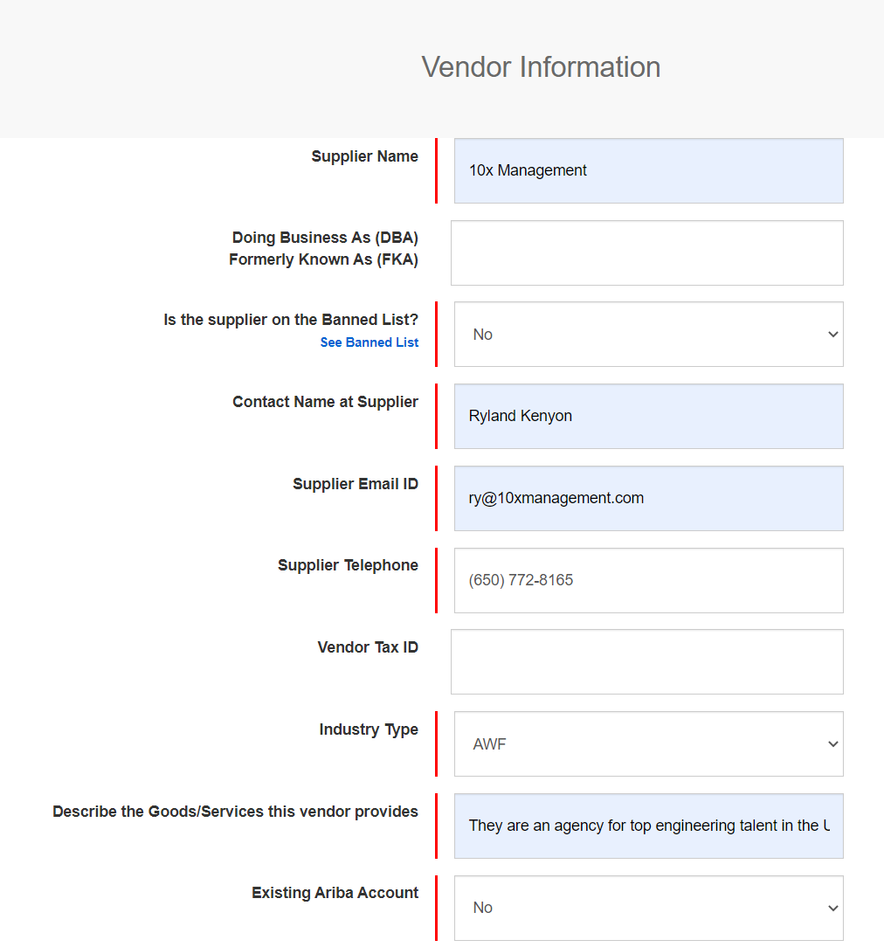
AWF Hiring 101 - Setting up and onboarding a new vendor to eBay
1
2
Go here and select “Request a new Supplier”
Fill in section 1 (Vendor Information) with the information you have from the agency

Slide 27
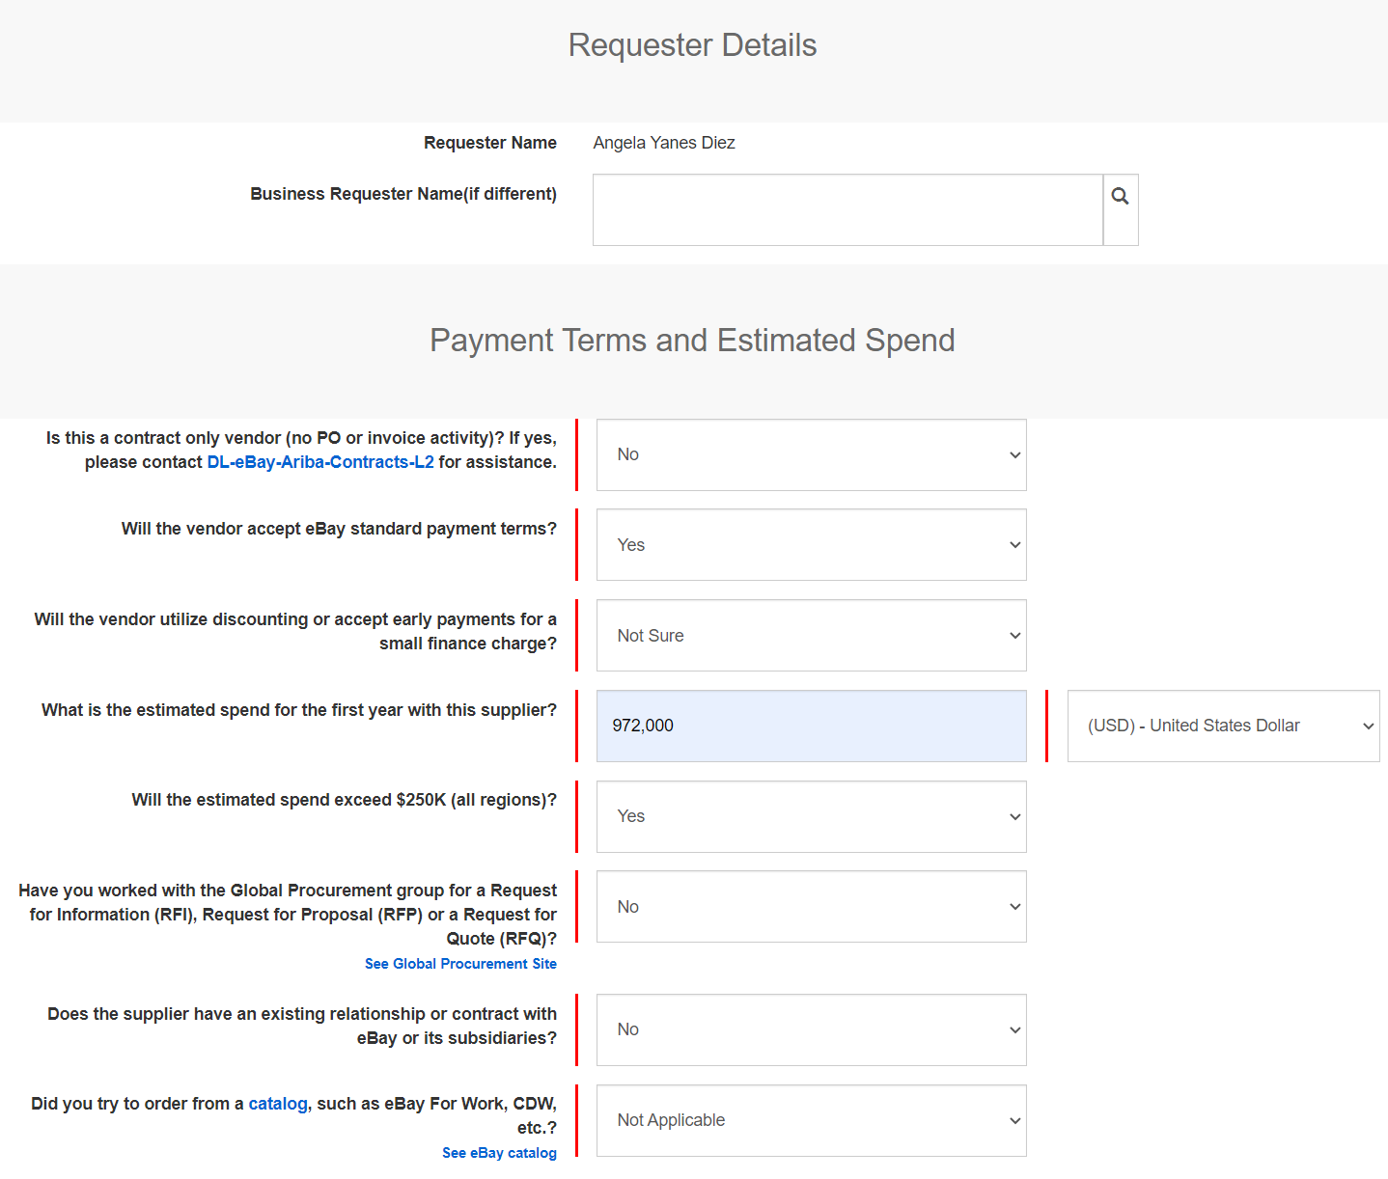
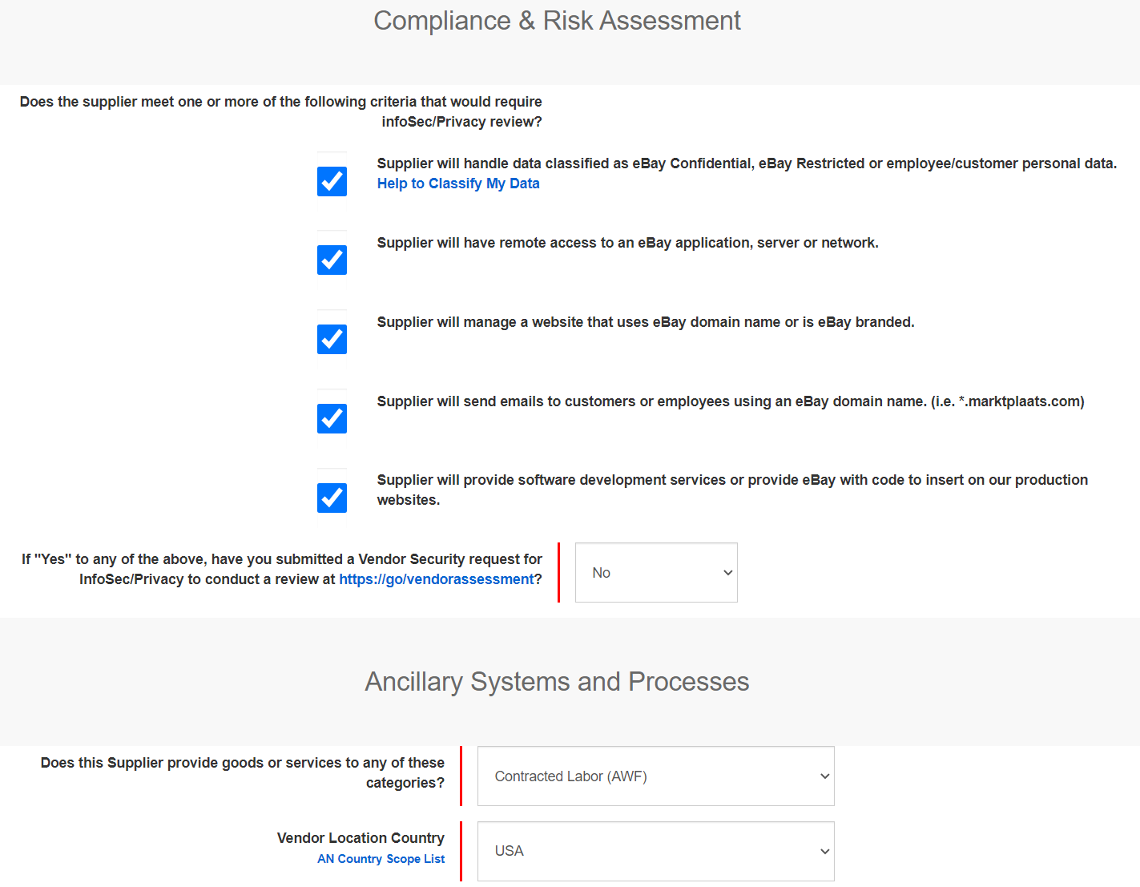
AWF Hiring 101 - Setting up a new vendor
3
4
Fill in sections 2 & 3 as follows:
Note: for estimated spend, do not go past $1M for the initial contract. Procurement and legal like to first assess the vendor prior to committing a large amount.
Fill in section 4 & 5 as follows:

Slide 28
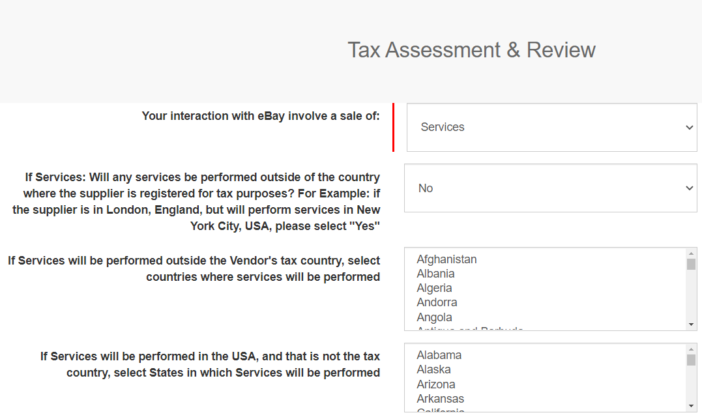
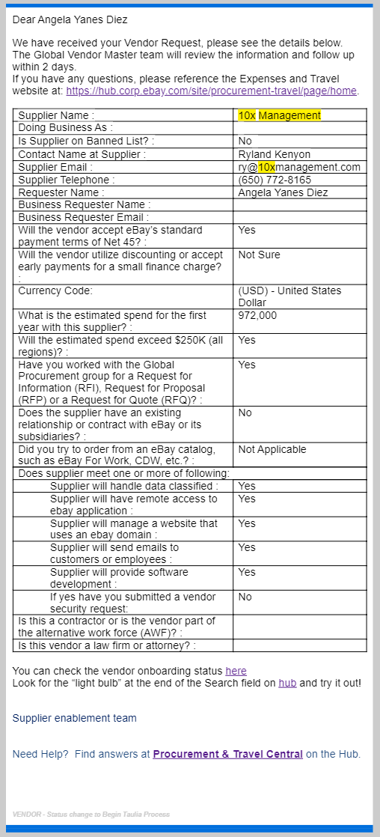
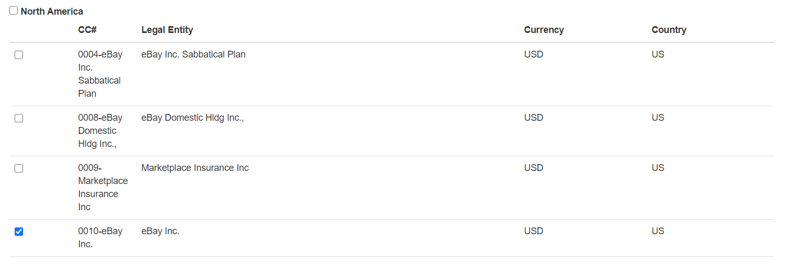
AWF Hiring 101 - Setting up a new vendor
5
6
Fill in section 6 & 7 as follows:
Note: This is for US only. If we want to extend to CN or NL, we’d need additional procurement guidance. Use CC 0010.
Submit - You will receive an email like this:
The procurement team will then update you when they have sent information to the vendor (you may receive an email from noreplysuppliersupport@ebay.com saying “Status Update: Invitation Sent”

Slide 29
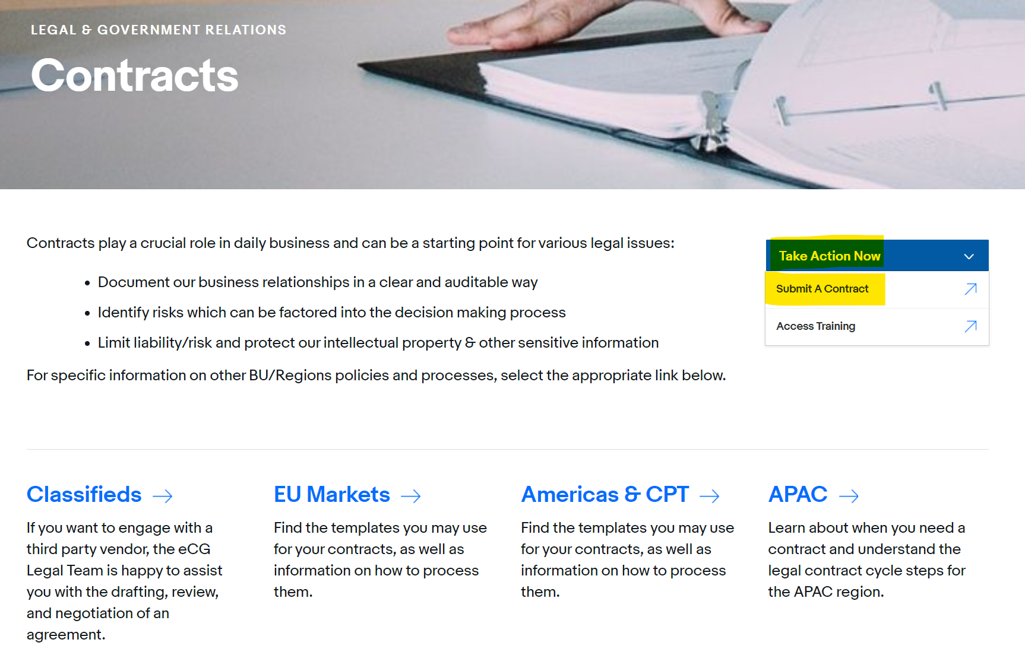
AWF Hiring 101 - Setting up a new vendor
7
8
Next steps still unknown
Once approved, we need to submit a contract. Go here and select “Take action now - Submit a contract”

Slide 30
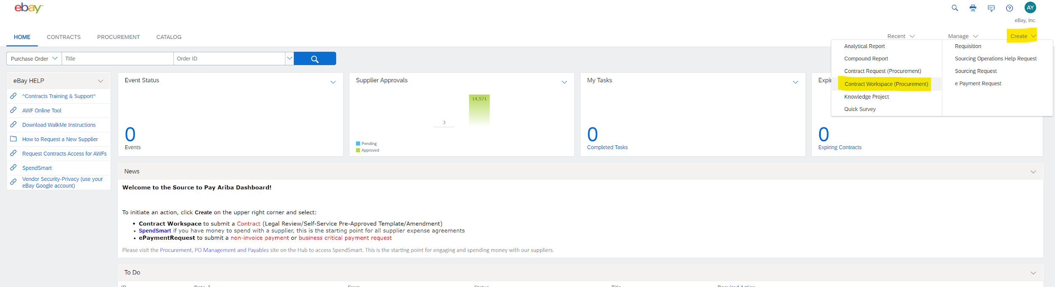
AWF Hiring 101 - Setting up a new vendor
9
In Ariba, select at the top right: “Create - Contract Workspace (Procurement)”

Slide 31
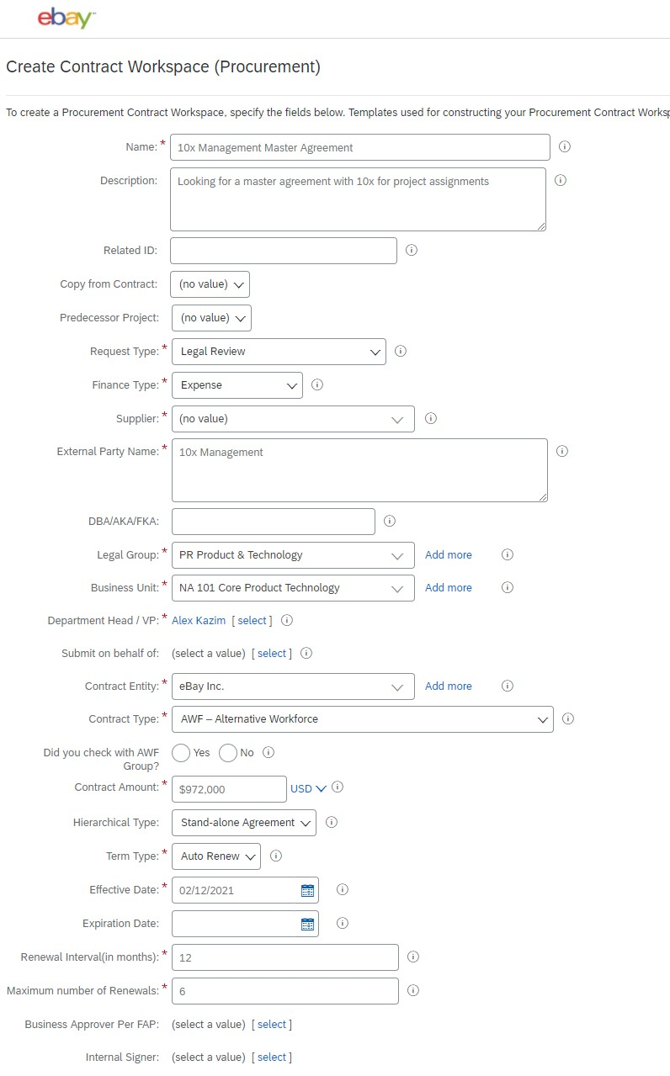
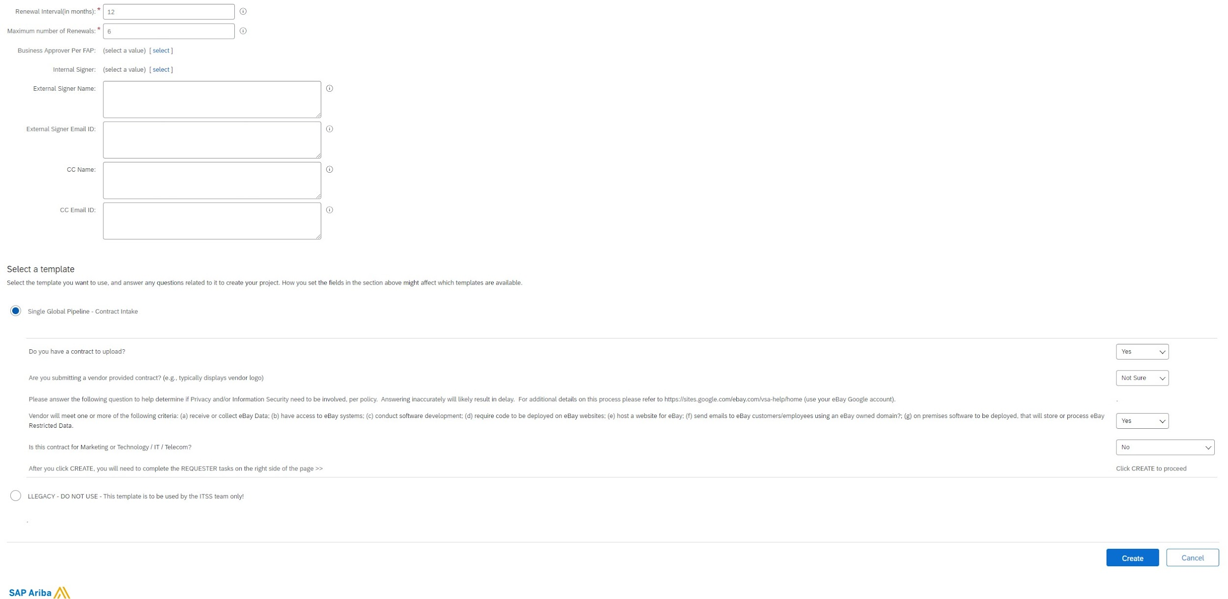
AWF Hiring 101 - Setting up a new vendor
10
Fill in as follows:
Supplier should appear once approved

Slide 32
AWF Hiring 101 - Setting up a new vendor
11
Next steps unknown

